Slide 1
Relational Schema
Converting
Transitioning
Mapping
Just remember to go step by step and you will be fine

Slide 2
DDL: Phase 1 Design, Phase 2 Build
ERD, EERD
Relational Schema
Keys (PK, FK, UN), candidate/alternate, composite (CPK)
Normalization (1st, 2nd, 3rd, Codd, 4th, 5th)
Data Dictionary
Create Tables, Views
SPROCS, Rules, Defaults, Triggers, Constraints, Indexes
SQL queries, complex queries, and joins.

Slide 3
4 Simple Rules to Remember for design:
Multivalued – Break out to a new table. PK becomes FK linking to PK of original table. New table still needs its own PK which will be the CPK of FK and the multivalued attribute.
Many to Many –PKs become the FKs in NEW linking table.
One to many – PK of one becomes FK in many.
One to One – PK of mandatory becomes FK in optional.
If both mandatory, either table can receive the FK.
If both optional, FK in table with fewest rows.

Slide 4
Entities and their relations, become tables and their relational arrows. The FK points back to the PK
This
This
to
Notice how this starts to look like the header row of a spreadsheet table?

Slide 5
Acme Example: From this…
Dependent entity
Associate entity

Slide 6
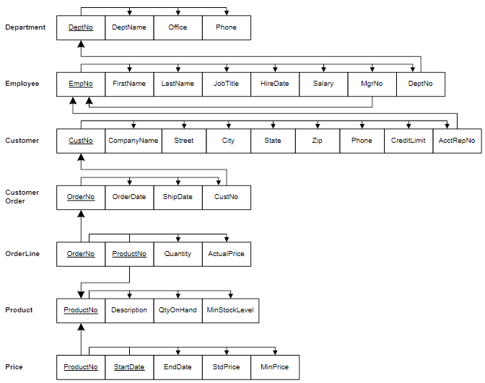
To this…
Linking Table

Slide 7
Detailed Application

Slide 8
Transforming ERDs into Schemas – “Mapping” THIS STARTS NORMALIZATION (1st form)
Step 1: Map Regular Entities to Tables…
Composite Attributes: Break into simple attributes.
Multivalued Attributes: Break out to separate table with a foreign key referencing the primary key of the table with original entity.
(leads to composite primary key (CPK) of the two attributes).
Derived Attributes: Are not included in a relational schema.
(represent data not stored, only calculated as needed).

Slide 9
Mapping a Compound Attribute
CUSTOMER entity with Address compound attribute
Customer table with simple attributes

Slide 10
Mapping a Multivalued Attribute
EMPLOYEE entity with Skill multivalued attribute
(b) Two resulting tables
Note the CPK in this table.

Slide 11
Transforming ERDs into Schemas – “Mapping” THIS IS THE REASON CARDINALITY and OPTIONALITY MATTERS
Step 2: Map Binary Relationships
One-to-Many: Primary key on the one side becomes a foreign key on the many side.
Many-to-Many: Break out to new table (association entity);
the primary key of the new table is typically a CPK comprised of the primary keys of the tables from the two entities involved in the relationship.
One-to-One: Primary key on the mandatory side becomes a foreign key on the optional side.
If optionalities are both mandatory, either table can receive the FK.
If optionalities are both optional, place FK in table with fewest rows.

Slide 12
Mapping a Binary 1:M Relationship
Relationship between CUSTOMER and ORDER (1:M)
Two resulting tables
Referential integrity arrow used to show the linkages between the tables.
Connects the FK of one table to the related PK of another table.

Slide 13
Mapping a Binary M:M Relationship
Notice the data intersection
Three resulting tables
Notice the CPK of the associative table linking to the originating tables

Slide 14
Mapping a Binary M:M Relationship (continued)
one DateAssigned value per Employee-to-Project assignment (the Date-Assigned is the Assignment start date):
more than one DateAssigned value per Employee-to-Project assignment (a DateAssigned value for each day worked) – requires unique for each entry:
two-column CPK.
three-column CPK.

Slide 15
Mapping a Unary 1:M Relationship
(Compare to Refs)
Employee table with recursive foreign key
Note mandatory use of synonym for FK.

Slide 16
Employee example as a table
PK
FK
EmployeeID | FirstName | LastName | DateOfBirth | ManagerID
137 | John | Doe | 03/15/1980
142 | Mary | Brown | 05/16/1982 | 137
170 | George | Turner | 11/04/1969 | 137
186 | Stephen | Smith | 09/17/1978 | 142
198 | Amanda | Walters | 12/17/1984 | 170
204 | Ernest | Hodges | 08/29/1972 | 137
267 | Michael | Rogers | 01/02/1985 | 170
285 | Juan | Rodriguez | 10/10/1968 | 137
323 | Kevin | McFadden | 11/11/1977 | 142
361 | Charles | Robideaux | 02/28/1980 | 142
Requires a column in the table to act as a recursive foreign key referencing the primary key of the table.

Slide 17
Mapping a Ternary Relationship
Notice Relation and Data Intersection is an associative entity here
Four resulting tables
Note the CPK of the associative table (linking table).
Remember that the CPK must represent a unique set of values.

Slide 18
Functional Dependency 2nd Normal Form
Relational tables
Functional attributes

Slide 19
Examples for you to Practice with

Slide 20
From This…

Slide 21
To this…
functional dependency arrows along the tops of the tables

Slide 22
This…

Slide 23
To this…

Slide 24
This…

Slide 25
To this…

Slide 26
Walkthrough: Break out tables, choose CPKs, connect tables Hospital, Acme

Slide 27
What you should know by now:
Entities, attributes, tables.
ERD, relations, cardinality, optionality.
Relational Schema, PK, FK, CPK, Candidate, Alternate
1st normal form.
2nd normal form.

